Slide 1
Humanitarian Uses of Data and Analytics
Dr. Dave Schrader
For Teradata University Network, January 2015
Send Questions or Comments to
drdaveschrader@gmail.com

Slide 2
Key Points
Non-profits need to use data and analytics to improve their insights about donors and project effectiveness
New Big Data types can be helpful to non-profits, e,g, tweets, text, geospatial
One way to help non-profits is to participate in Data Dives; donate your time and ability to analyze their data
Kaggle is another way for non-profits to get analytics help

Slide 3
Topics
American Red Cross (and University of Maryland)
Data Dives with DataKind
Kaggle Contests

Slide 4

This Talk Highlights Analytics Using Traditional and Big Data
Analytics and visualizations of
Big Data types can help non-profits:
Text
Tweets
Geospatial location information
Satellite images
Sensors
Video, audio, image

Slide 5
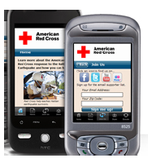
American Red Cross
Situation
Prevent and alleviate human suffering in the face of emergencies by mobilizing the power of volunteers and the generosity of donors.
Problem
70,000 disasters per year. Large amounts of data: 9M blood products involving 3000 hospitals and transfusion centers, first aid and CPR training for 7M people per year. Need to mobilize 10M volunteers and donors when needed. Investigating opportunities to use social media (SMS, tweets)
Solution
Uses Teradata as the core EDW. Research project with University of Maryland to analyze tweets to understand nature and location of emergencies, better target volunteers, optimize blood/$ donations.
Increasing organizational effectiveness during disasters – 5 hours to create / execute a campaign
Personalized help appeals, with 360 degree view of each volunteer
Donor Analytics – who, what, when, which channels, what drives donations
Compare mobile/online donations, correlations to tweets, geography
Impact
Notes:
Presentation at Partners 2013 by Chris Taylor of American Red Cross and Prof. Bill Rand from University of Maryland

Slide 6
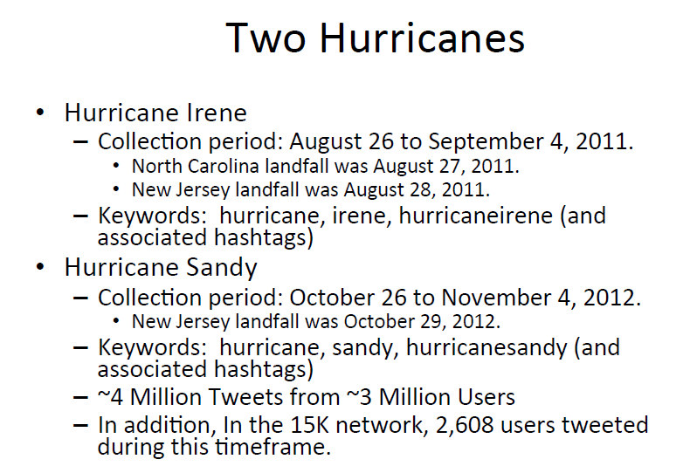
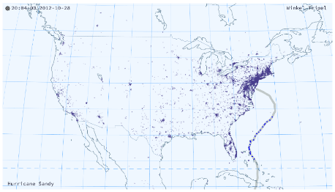
American Red Cross worked with U-Maryland Tweet Analytics
Prof. Bill Rand,
Univ. of Maryland
12/11/2014
6
Notes:
Presentation from 2013 Partners by Prof. Bill Rand, used with permission

Slide 7
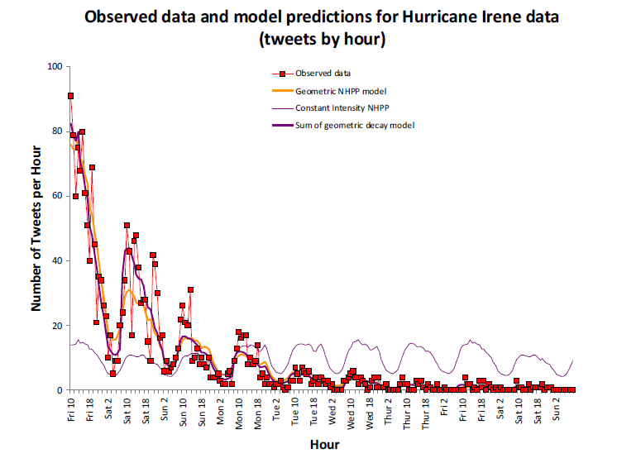
Tweets by Hour – Hurricane Irene
Prof. Bill Rand,
Univ. of Maryland
Notes:
Presentation from 2013 Partners by Prof. Bill Rand, used with permission

Slide 8
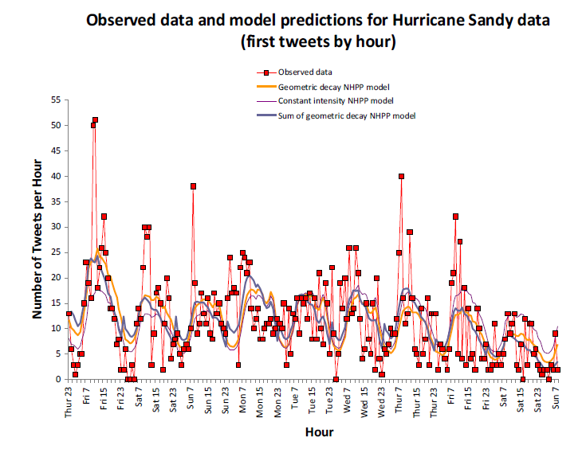
Tweets by Hour – Hurricane Sandy
Prof. Bill Rand,
Univ. of Maryland
Notes:
Presentation from 2013 Partners by Prof. Bill Rand, used with permission

Slide 9
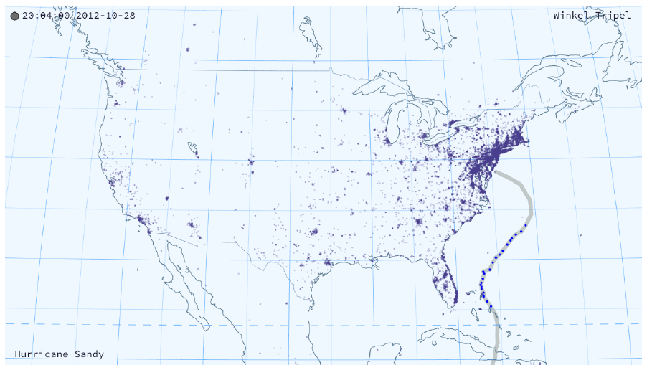
Geographic Location of Tweets - Animation
Prof. Bill Rand,
Univ. of Maryland
Notes:
Presentation from 2013 Partners by Prof. Bill Rand, used with permission

Slide 10
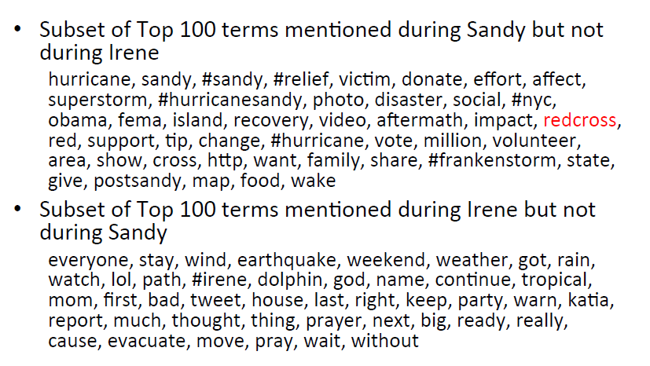
Differential Analysis - Tweet Terms
Prof. Bill Rand,
Univ. of Maryland
Notes:
Presentation from 2013 Partners by Prof. Bill Rand, used with permission

Slide 11
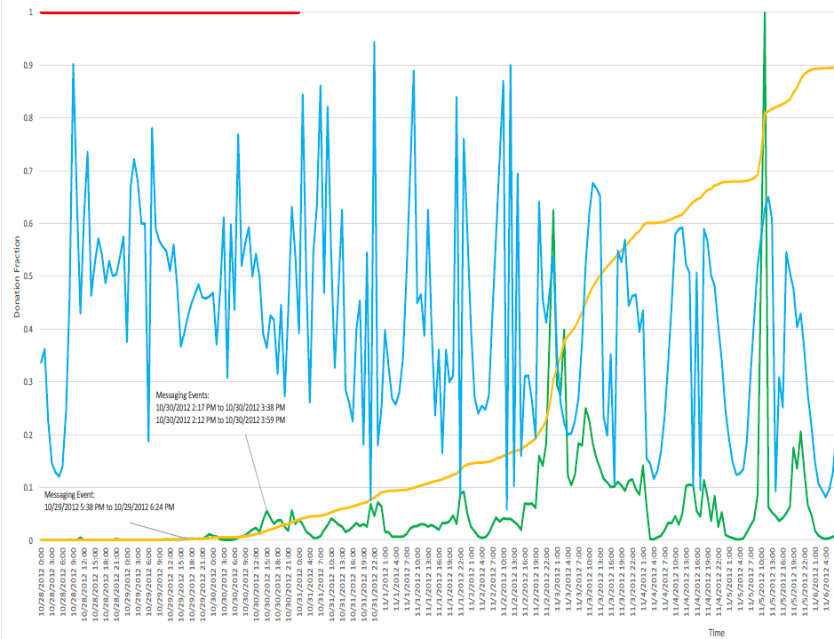
Correlating Tweets to Donations Over Time
Tweet counts fairly constant over several weeks = “high need”
Donation spikes correlated with fundraising appeals, e.g., NPR
Prof. Bill Rand,
Univ. of Maryland
Notes:
Presentation from 2013 Partners by Prof. Bill Rand, used with permission

Slide 12

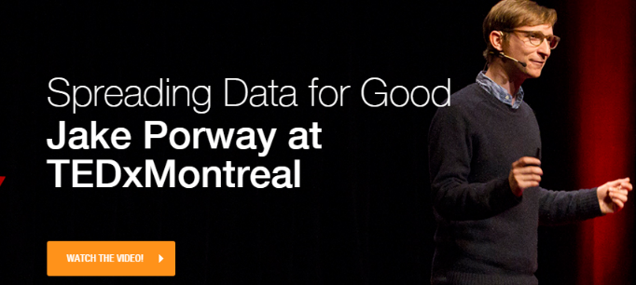

Dave Dives with DataKind
See www.datakind.org

Slide 13
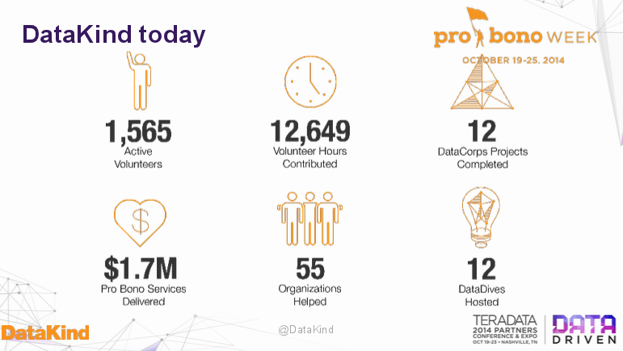
Notes:
Slides from DataKind readout at end of the Data Dive, Teradata Partners 2014
Used with permission from Jake Poway

Slide 14
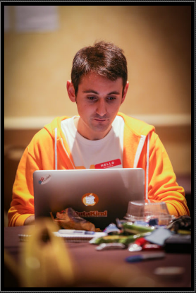
Data Dives at the Teradata Partners Event October 2014
Sponsored by Teradata Cares
4 non-profit groups brought their data
Paired non-profits up with 4 teams
Teradata customers and employees who came in a day early, plus university students
Idea is a “Data Dive”
Help these charities discover insights from their data, apply analytics
Notes:
Slides from DataKind readout at end of the Data Dive, Teradata Partners 2014
Used with permission from Jake Poway

Slide 15

Global Giving: Crowdfunding for Charities
Notes:
From the GlobalGiving.com website, Dec 2014

Slide 16
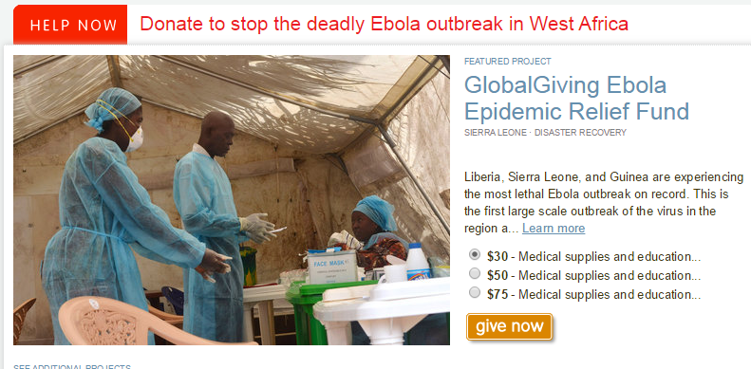
Global Giving Creates Web Sites for Projects
Notes:
From the GlobalGiving.com website, Dec 2014

Slide 17
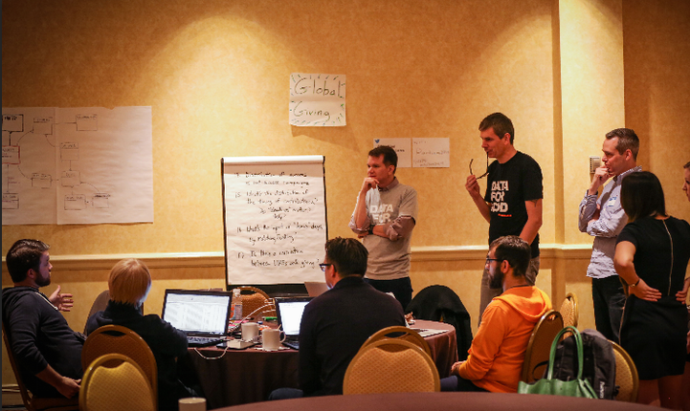
Our Group Was Intense!
And Very
International:
Russia
Netherlands
UK
India
Americans
Notes:
Picture from the GlobalGiving DataDive at Teradata Partners 2014

Slide 18
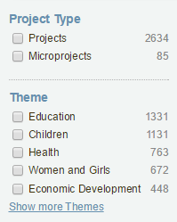
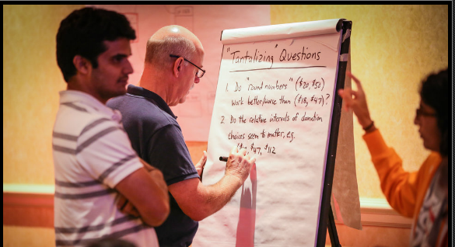
Global Giving Brought Their Data
2,800+ projects so far, 413K donors
Raised more than $158M in donations
Their data model, web layout
“Day in the Life of a Donation”
We created 25 “tantalizing
questions” we might be
able to answer …
Notes:
Information from GlobalGiving website

Slide 19
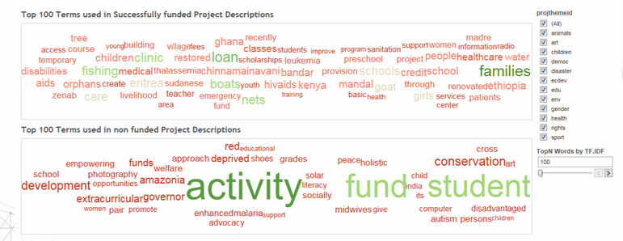
Which Description Terms “Worked”? “Didn’t”? Top Keyword Driving Donations in Projects That Achieved Their Goal?
GOAT!
Notes:
Slides from DataKind readout at end of the Data Dive, Teradata Partners 2014
Used with permission from Jake Poway

Slide 20
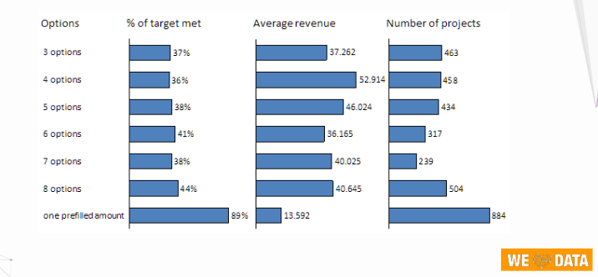
Does # of Donate Buttons Have an Impact?
Notes:
Slides from DataKind readout at end of the Data Dive, Teradata Partners 2014
Used with permission from Jake Poway

Slide 21

“I Could Be” – Online Mentoring

Slide 22
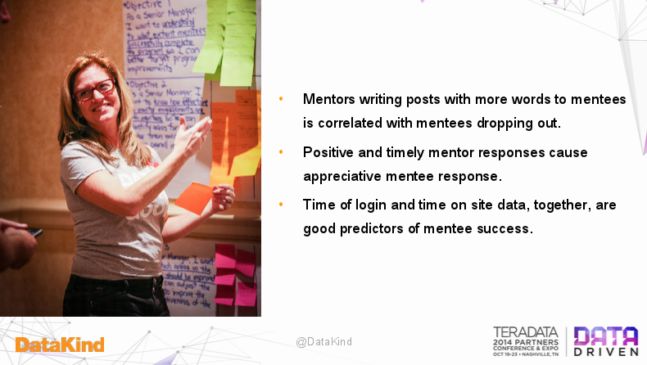
Analytics of Mentor/Mentee Communications
Text analytics ---
length of messages, tone of messages, response timing
Notes:
Slides from DataKind readout at end of the Data Dive, Teradata Partners 2014
Used with permission from Jake Poway

Slide 23
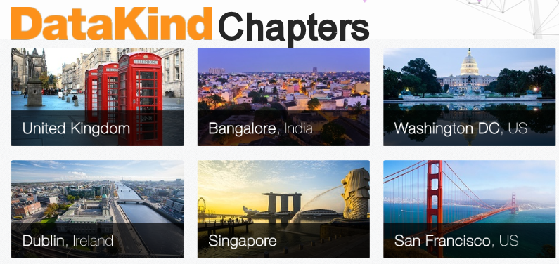
How Cool Would It Be to
Have CHAPTER in Your City?
Notes:
Slides from DataKind readout at end of the Data Dive, Teradata Partners 2014
Used with permission from Jake Poway

Slide 24

Kaggle
What do you do if you have data
but no data scientists or analysts?
Answer: put your date online
and create a Contest !

Slide 25
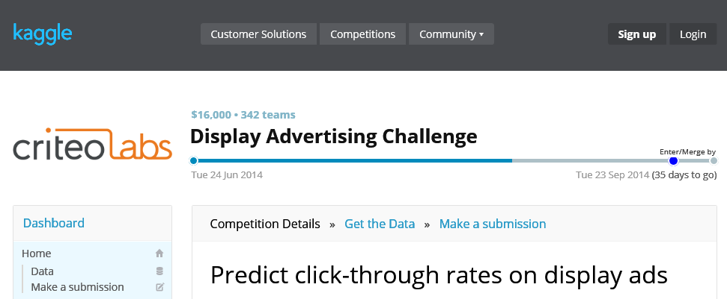
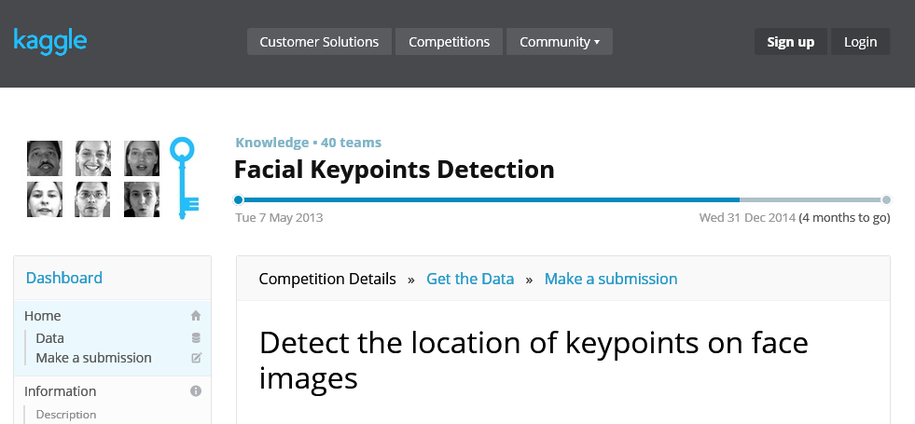
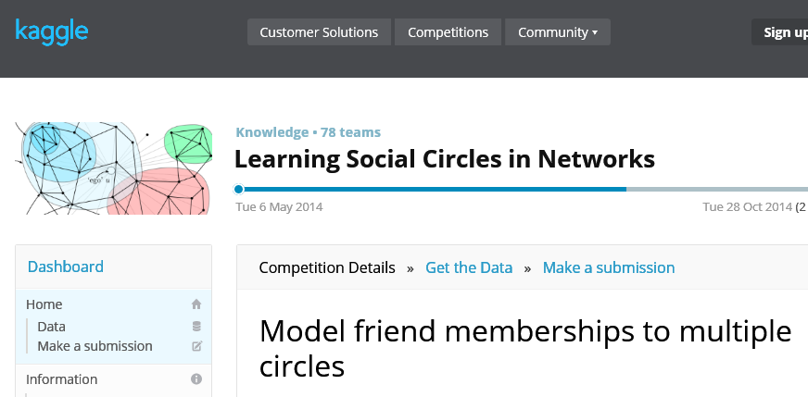
Notes:
Slide has overlays of various Kaggle contests, taken from Kaggle website, fall 2014

Slide 26
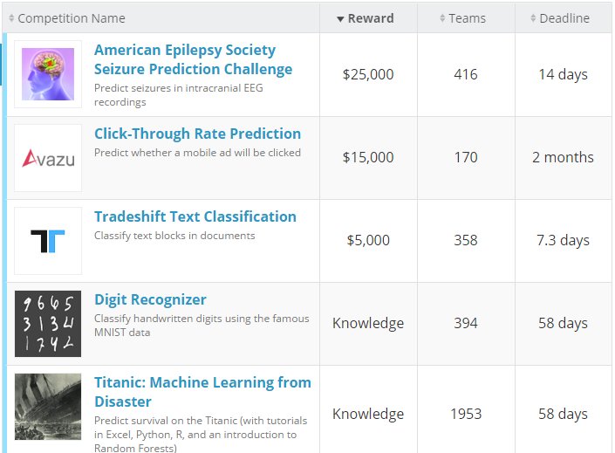
Notes:
From Kaggle website, Dec 2014

Slide 27
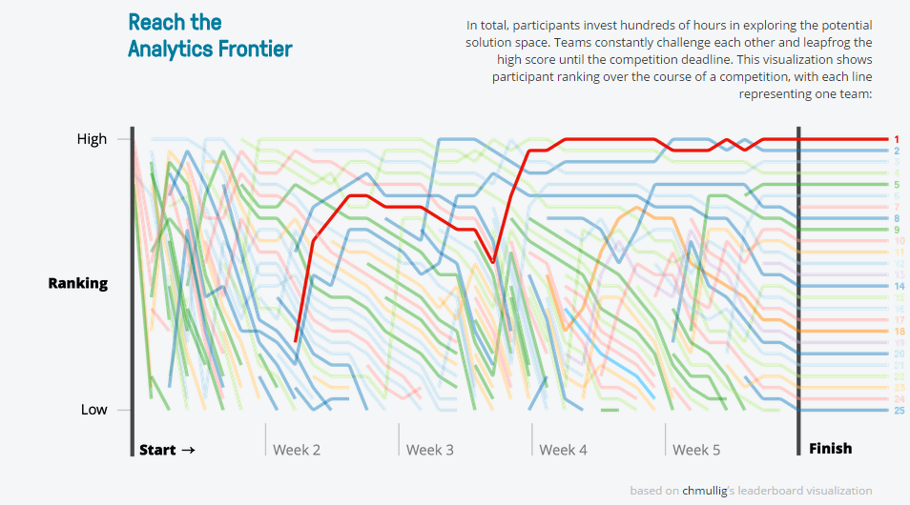

Sample Competitions
Notes:
From Kaggle website, Dec 2014

Slide 28
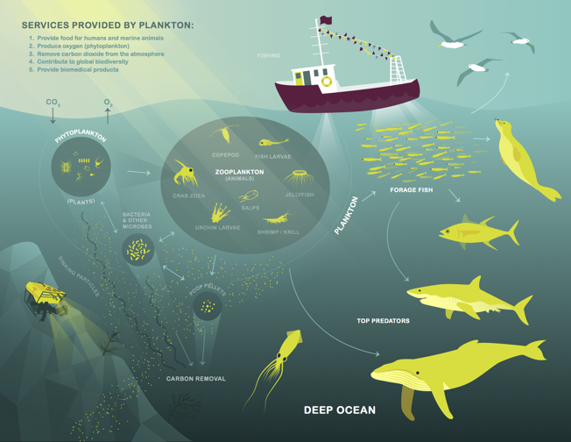
Counting Plankton – Help the Oceans
Sponsored by Oregon State University – Hatfield Marine Science Center
Create automated image analytics (machine learning algorithms) on inputs from towed sensors to count and catalogue plankton types
Helps to monitor the health of the oceans, focus efforts to improve marine food webs, fisheries, ocean conservation
See https://www.kaggle.com/c/datasciencebowl
Notes:
From Kaggle website, December 2014

Slide 29
Wrap Up – Key Points
Non-profits need to use data and analytics to improve their insights about donors and project effectiveness
New Big Data types can be helpful to non-profits, e,g, Tweets, text, geospatial
One way to help non-profits is to participate in Data Dives
Kaggle is another way for non-profits to get analytics help

